Slide 2
Welcome!

Slide 3
Who We Are
One Breath, One Hope
Executive Board
Meghan Montana – CEO
JoAnn Kelly – Treasurer
Barbara Jarvis – Secretary
Amy Hermann – Director of Communications
Jennifer Marrero – Director of Fundraising
Mel & Sara Manwaring – Founding Members

Slide 4
What is a "Rare Disease”?
In the US, a rare disease is categorized as a disease that effects fewer than 200,000 people.
There are more than 6,800 defined rare diseases that affect about 25-30 million americans
1 in 10

Slide 5
Types of Rare Diseases
80% of rare diseases are “genetic rare diseases”
The rest are related to other factors
All areas of the body can be affected
Neurological
Muscular
Skeletal
Body organs and systems

Slide 6
Examples of Rare Diseases
Primary Ciliary Dyskinesia (PCD)
Niemann – Pick Type C (NPC)
Hereditary Breast and Ovarian Cancers
Cystic Fibrosis
Muscular Dystrophy
And Many More…

Slide 7
PCD– Primary Ciliary Dyskinesia
Rare Genetic Disease
Affects about 25,000 people in the US, 400 with an official diagnosis
Inherited gene
17 genes known to be linked to PCD

Slide 8
PCD Genes
PCD DNAI1
DNAAF3
DNAH5
HYDIN
NME8
DNAH11
DNAI2
DNAAF2
(C14orf104)
RSPH4A
RSPH9
DNAAF1
(LRRC50)
CCDC39
CCDC40
DNAL1
CCDC103
HEATR2
LRRC6

Slide 9
Siblings
Each sibling of an affected PCD individual has:
25% chance of having PCD
50% chance of being a carrier
25% chance of being completely unaffected

Slide 10
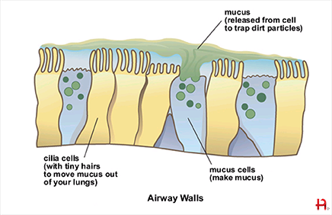
What is Cilia?

Slide 11
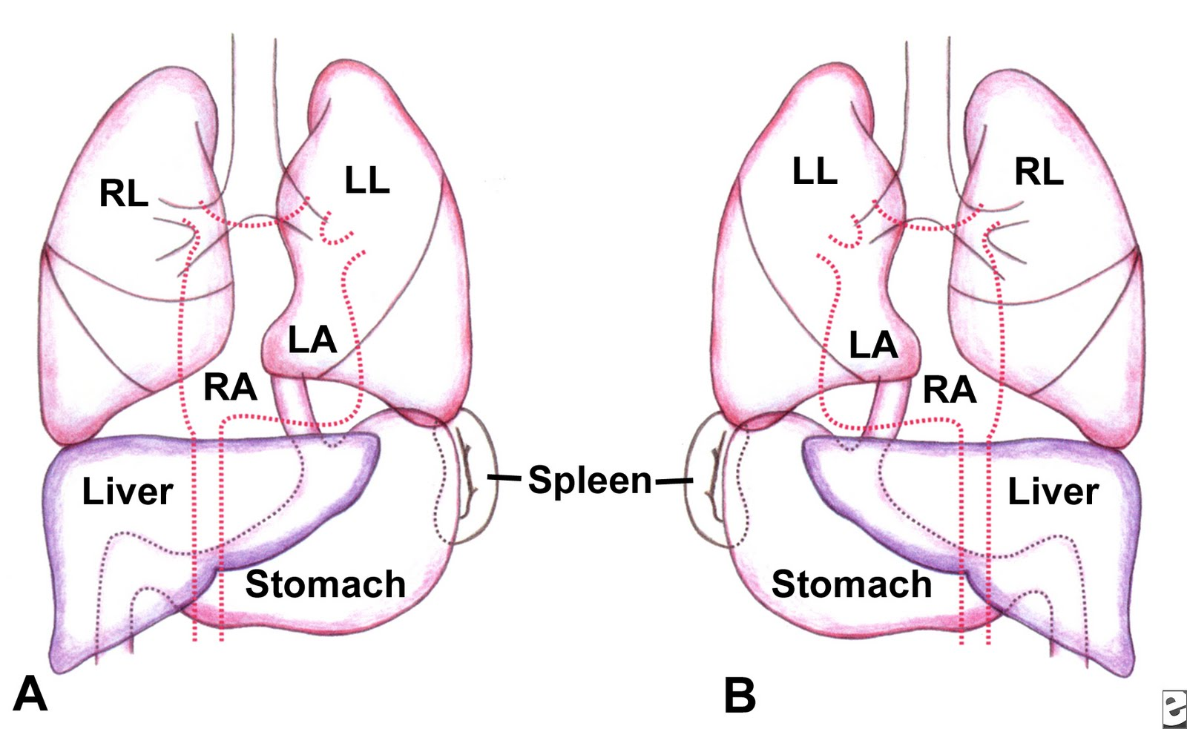
Situs Inversus

Slide 12
Diagnosis
Accepted Official Diagnosis
Genetic Testing
Ciliary Biopsy – “Gold Standard”

Slide 13
Treatments
Medications
Mucus thinners
Airway relaxers
Antibiotics
Steroids
Airway Clearance Therapy (ACT)
Hand clapping/cupping
Vest

Slide 14
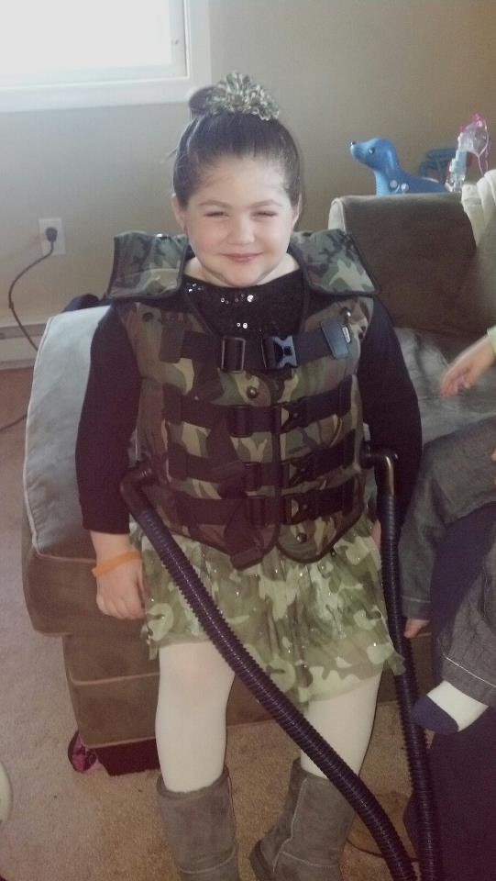
“The Vest”

Slide 15
Our Story…

Slide 16
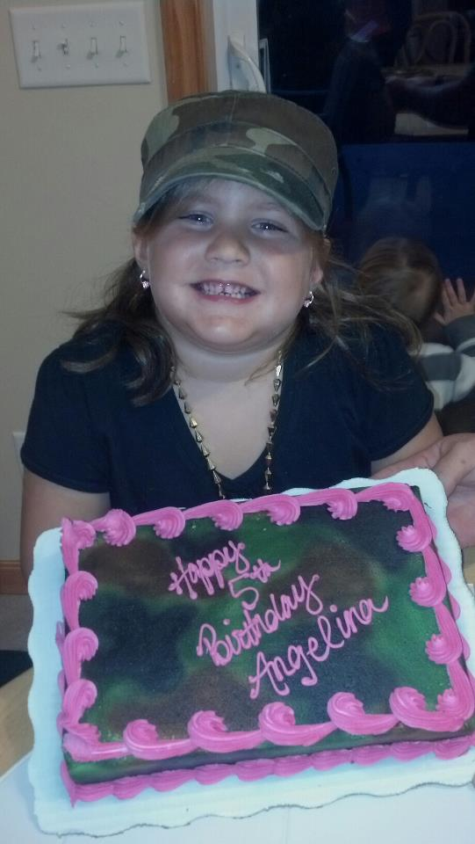
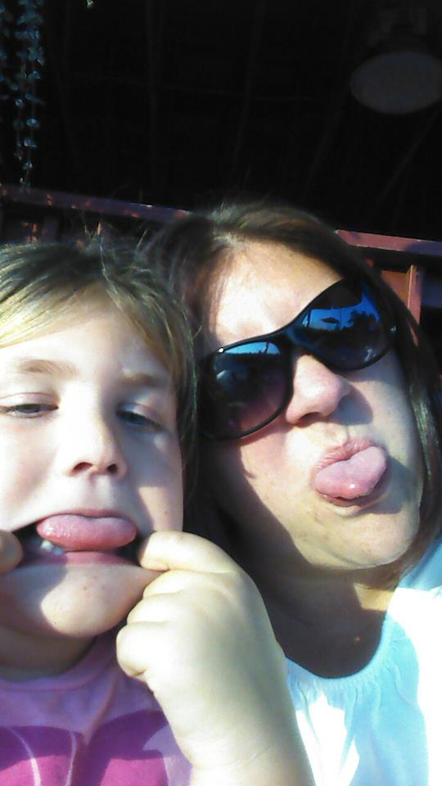
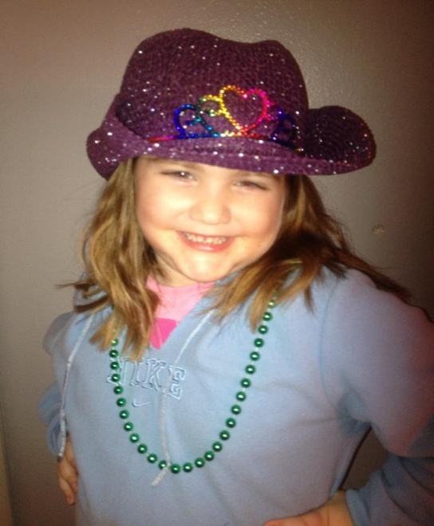
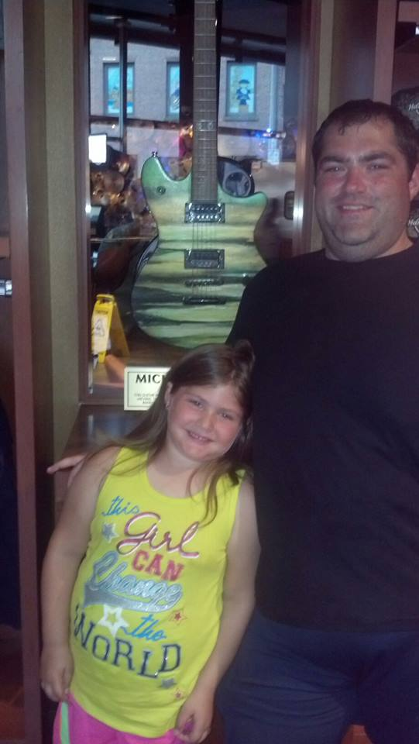
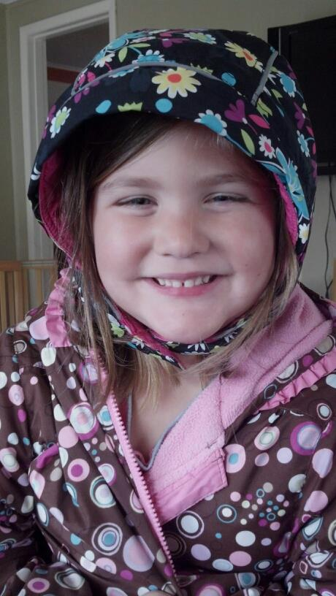
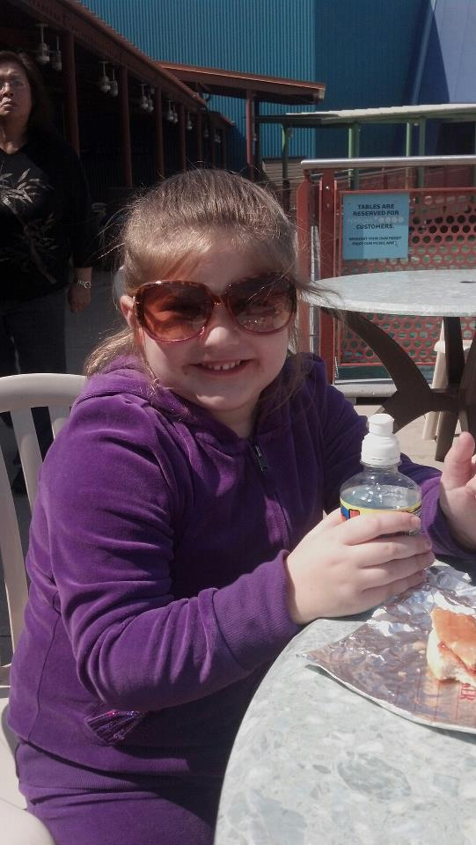
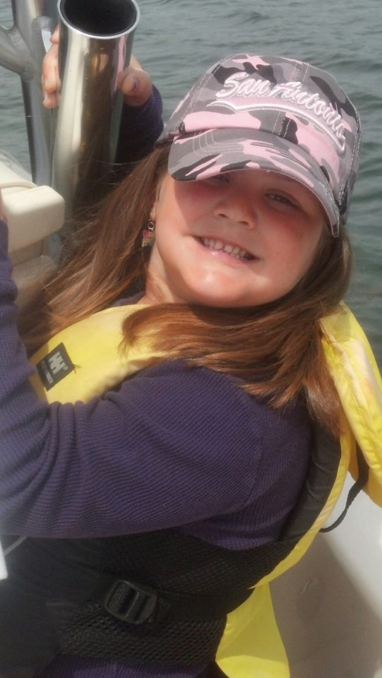
Angelina

Slide 17
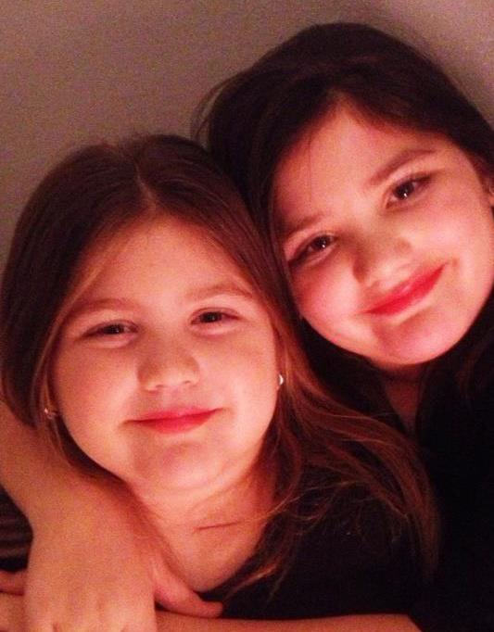

Slide 18
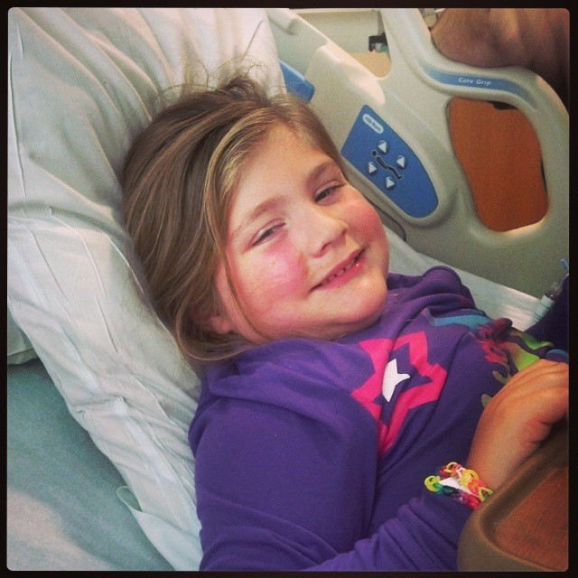

Slide 19
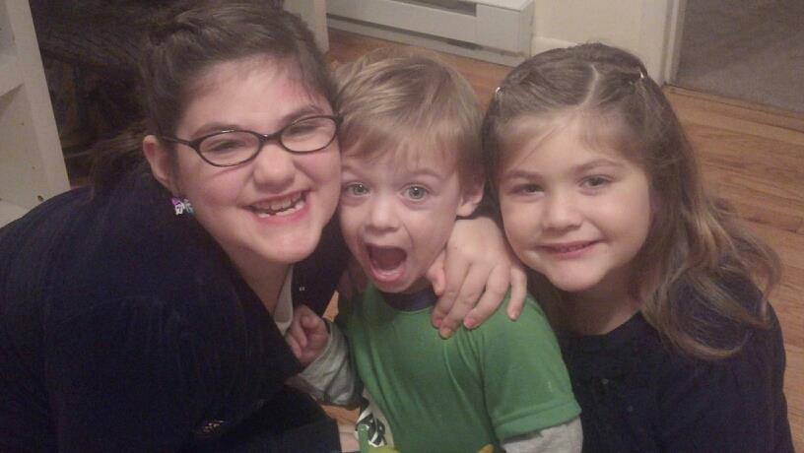

Slide 21
One Breath, One Hope
Helping individuals and families affected by PCD and other rare diseases to breathe a sigh of relief and feel a moment of hope…
Provide financial support to individuals and their families so they can receive needed treatments, visit specialized doctors and facilities, and aid with any other related expenses such as travel, medical equipment and more.
Connect individuals and families with similar support groups and families who can provide valuable information, networking, and emotional support.
Advocate for research and education by working with PCD expert centers, doctors, and hospitals.

Slide 22
Questions?

Slide 23
Thank You!

